Slide 1
National Defense University
Electives and Concentrations
CAPT Richard Knight
Academic Affairs, Chief of Staff
02 August 2022

Slide 2
Non-Core Courses
Enhance students’ professional and educational opportunities
Electives
Concentrations
Research and Independent Study
NDU Scholars Program

Slide 3
Elective v. Concentration
Elective Opportunities
NWC
ES
CIC
CISA
1 in fall, 1 in spring, +1 in fall or spring
1 in fall, 1 in spring
1 in fall, 1 in spring, +1 in fall or spring
Area of Concentration courses: College to provide more information. Additional electives require “overload.”
Elective A
Elective B
Elective C
Elective D
Elective E Elective F
Elective G
Degree with Concentration
Degree
Elective H
Elective I
Elective J Elective K Elective L Elective M Elective N

Slide 4
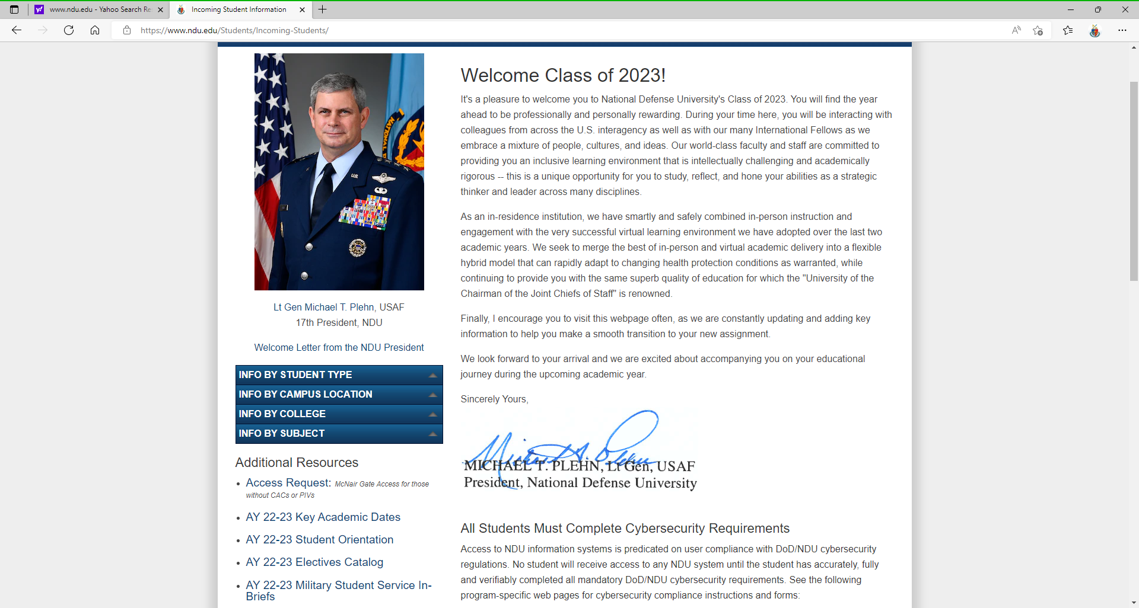
Electives Selection
Concentration Breakouts
Electives Fair
Top 5 Electives
(survey link)
Tue, 02 Aug
Wed, 10 Aug
1200-1330
Mon, 15 Aug
NLT 0800
Electives Catalog at www.ndu.edu under “Incoming Students”
Classes with space available will be announced for “overloads” and audits
Students
Faculty/Staff *
Spouses *
* Requires Professor Approval

Slide 5
Concentrations
American Studies (IF) / Fellows (US) - Prof. Michael S. Shrout MH 154 (ISMO) (202) 685-3944 michael.shrout.civ@ndu.edu
Cyber Studies - Prof Roxanne Everetts MH 136 (202) 685-4887 roxanne.everetts@ndu.edu
Data and Disruptive Technologies - Prof Andy Gravatt MH 129 (202) 685-4886 gravatta@ndu.edu
Ethics - Dr. Gregory D. Foster LH 2522 (202) 685-4166 fosterg@ndu.edu
European Defense, NATO, and Transatlantic Cooperation LH 2617 (202) 685-2369 lisa.a.aronsson.civ@ndu.edu
- Dr. Lisa Aronsson
Financial Management - Prof David A. Harvey MH 209C (202) 685-3648 david.a.harvey.civ@ndu.edu
Global Supply Chain & Logistics (ES only) - Dr. Todd L. McAllister LH 3610 (202) 685-2166 t.l.mcallister.civ@ndu.edu
Health Strategies - Dr. Douglas J. Robb MH 314M (202) 685-4246 douglas.j.robb.civ@ndu.edu
Influence Warfare - Dr. Howard Gambrill Clark MH 120 (202) 685-2782 howard.g.clark.civ@ndu.edu
National Security Interagency Leadership-Practicum (NSIL-P)
- Lt Gen Michael T. Plehn
- Mr. Kenneth E. Kligge LH 1627 (202) 685-4699 kliggek@ndu.edu
Senior Acquisition Course (ES only) - Dr. Bobby Ralston LH 2512 (202) 433-1033 robert.l.ralston.mil@ndu.edu
War Studies - Dr. Robert B. Watts RH 150 (202) 685-3708 wattsr3@ndu.edu

Slide 6
NDU Scholars Program
Conduct focused research on topic current, relevant, and of strategic importance to CCMD
Research on strategic policy and other issues provided by CCMD
Focus elective courses on strategic issues related to CCMD's AOR
Brief senior CCMD leader and CCMD staff on research findings
Earn additional certificate / recognition of expertise on transcripts
Follow-on assignment not required (except PACOM)

Slide 7
NDU Scholars Contact List
All NSP information is on Blackboard.
Faculty Advisors
ES James Van De Velde james.r.vandevelde.civ@ndu.edu
JFSC Mary Bell mary.s.bell.civ@ndu.edu
NWC Mark Bucknam mark.bucknam@ndu.edu
CIC Jim Churbuck ChurbuckJ@ndu.edu
CISA COL Laurinda Reifsteck l.m.reifsteck.mil@ndu.edu

Slide 8
Concentration/Scholars Program Breakouts
HPCON B
Location Capacity
NDU Café Dining 80
ALH South Atrium N/A
*MH 155 A, B, C 130
MH Atrium N/A
International Student Ctr N/A
ALH Room1107 49
ALH Room 1119 50
*Overflow Area: MH Room 155
Wait there if:
Uncomfortable with crowd size
Between briefings to:
Reduce corridor traffic
Review Concentration information
Reflect on day's events

Slide 9
NDU Orientation
Concentration and Scholar Program Breakout Sessions
HPCON B Room Capacity Usage
Overflow Area ​
Wait here if:​
Uncomfortable with crowd size​
Between briefings to:​
Reduce corridor traffic​
Review Concentration information​
Reflect on day's events​
Primary Traffic Flow From ALH Auditorium
Primary Traffic Flow From ALH Auditorium
NDU Scholars Program
Ethics
MH 155 A, B, C
ISMO Area
War Studies
NDU Cafe
ALH South Atrium
National Security Interagency Leadership Practicum (NSIL-P)
European Defense, NATO, and Transatlantic Cooperation
American Studies International and American Fellows
Cyber Studies
Data and Disruptive Technologies
Health Strategies
Financial Management
MH Atrium
Influence Warfare
Primary Traffic Flow From ALH Auditorium
Walkway
Primary Traffic Flow From Arnold Auditorium
Primary Traffic Flow From Arnold Hall
Senior Acquisition Course (ES ONLY) LH Rm 1119
Rms 1107 & 1119
Global Supply Chain & Logistics (ES ONLY)
LH Rm 1107

Slide 10
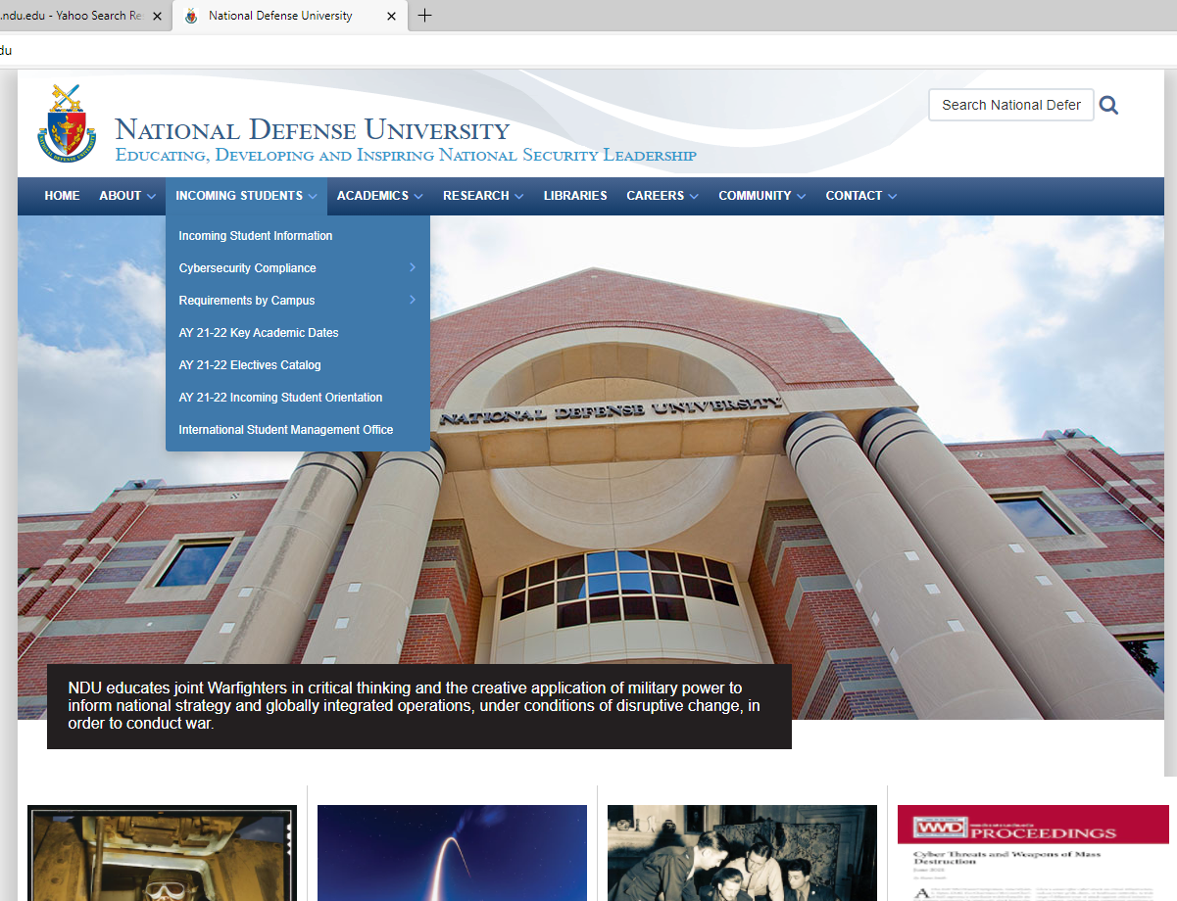
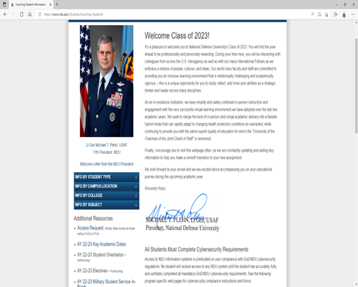
Access to Briefs
What if I have a question 3 months from now?
https://livestream.com/ndulivestream/events/10558092

